Slide 1
Coronavirus
COVID-19

Slide 2
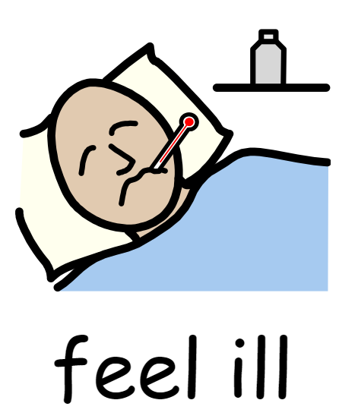
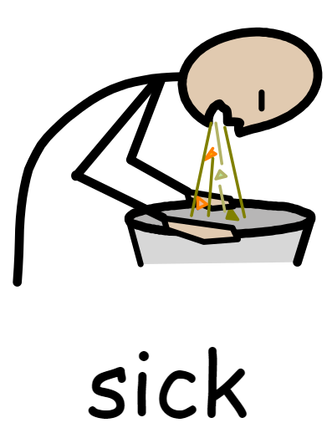
What is a virus?

Slide 3
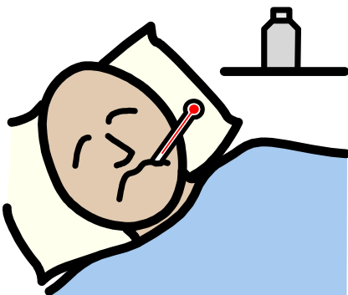
There is a virus called the Coronavirus which is making a lot of people in the world ill

Slide 4
Coronavirus

Slide 5
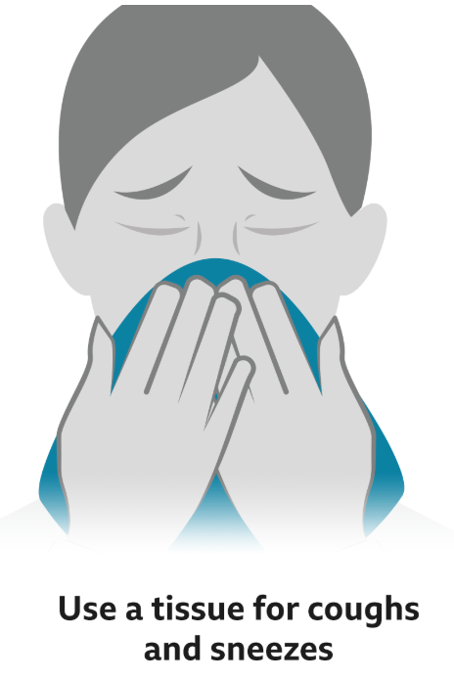
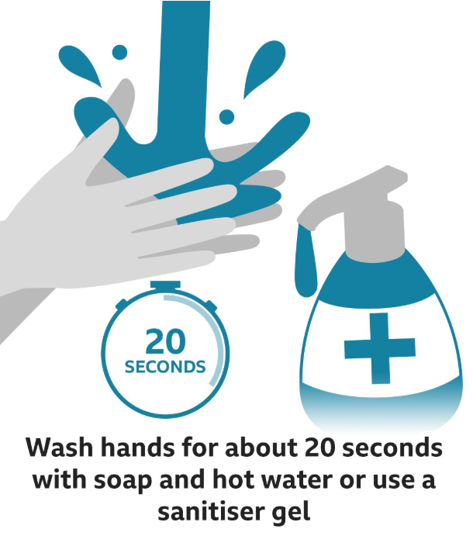
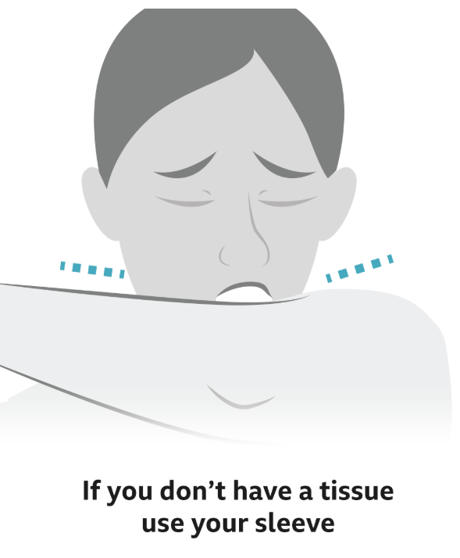
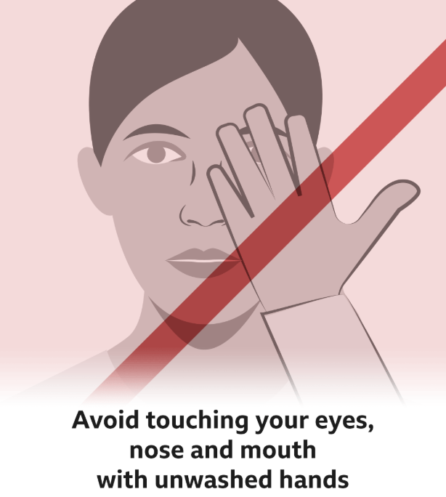
How to stay safe and healthy

Slide 6
You can tell staff if you feel ill. They will help you.

Slide 7
Washing hands

Slide 8
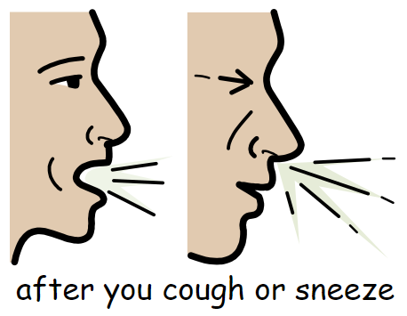
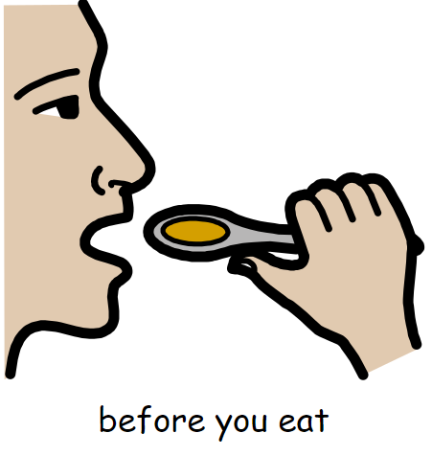

Slide 10
